Slide 1





Strategies to overcome barriers

Slide 2
Strategies to overcome barriers
📍ʙᴀʀʀɪᴇʀ
Barriers is anything that prevents,restrict,impedes the comunication between two or more persons in a social setting

Slide 3
📍ʙᴀʀʀɪᴇʀS ɪɴ ɪɴᴛᴇʀᴘᴇʀSᴏɴᴀʟ ʀᴇᴀʟᴀᴛɪᴏɴSʜɪᴘ
.Physiological barrier
.Environmental barrier
.Psychological barrier
.Social barrier
.cultural barrier
.sementic barrier
.organizational barrier
.communication process related barrier

Slide 4
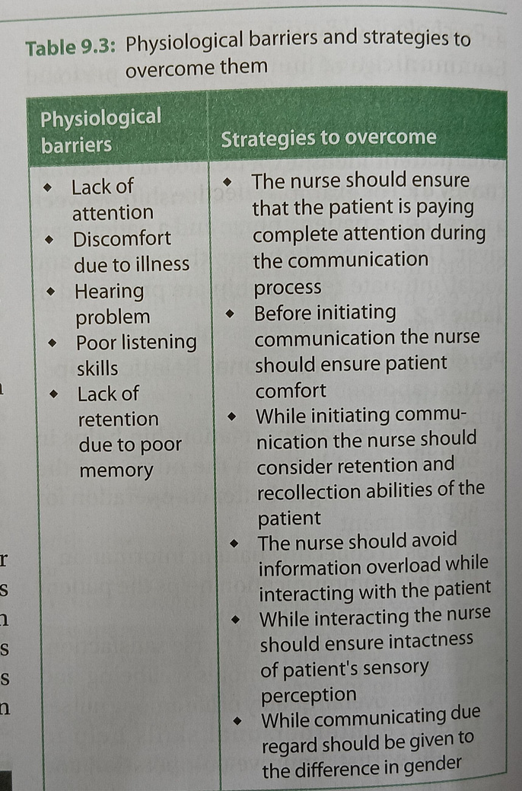

Slide 5
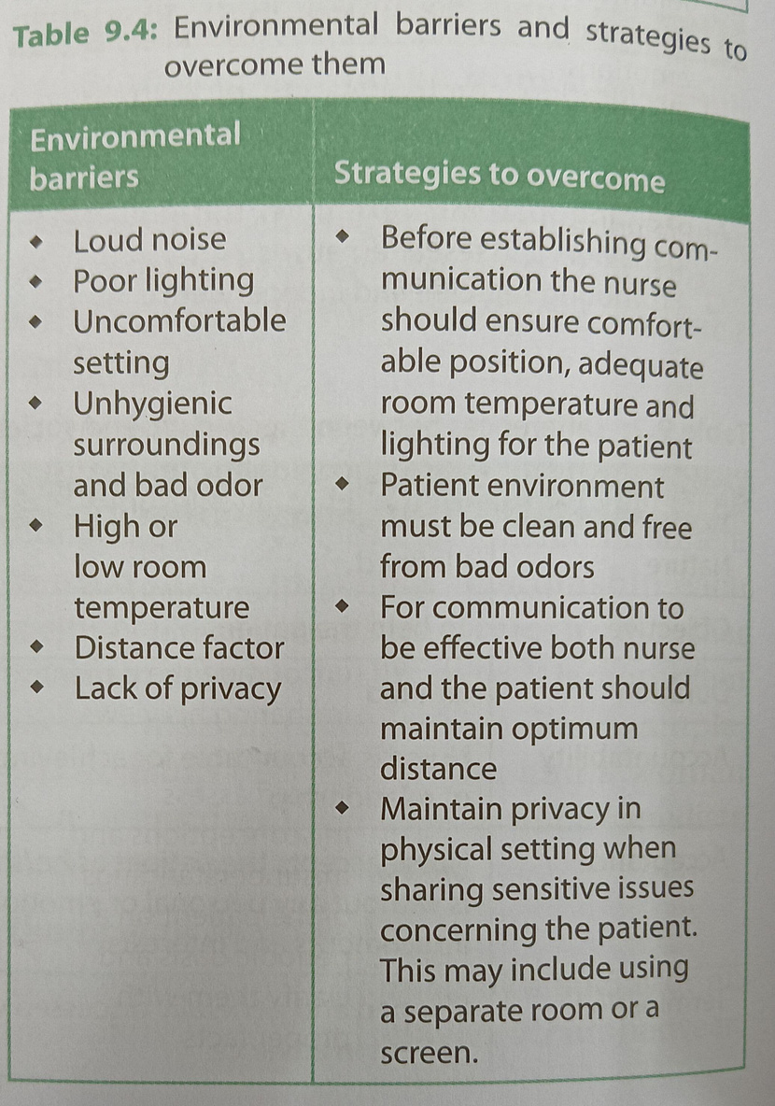

Slide 6
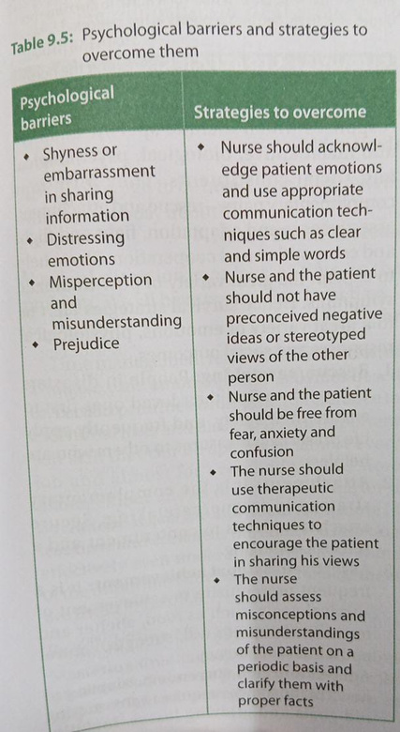

Slide 7
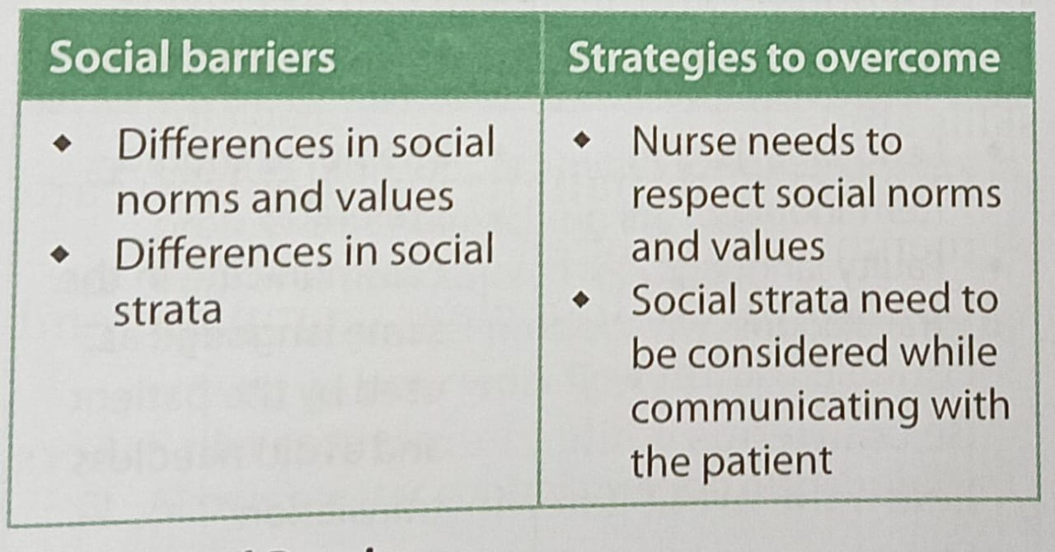

Slide 8
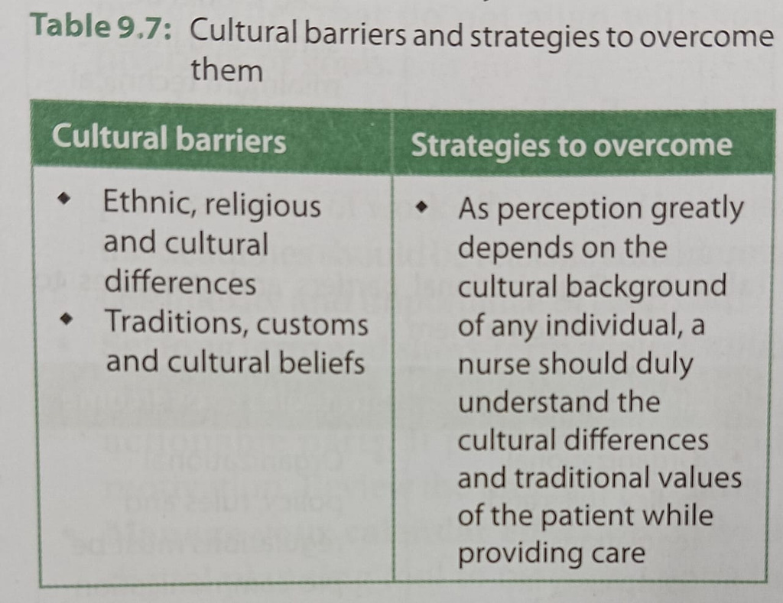

Slide 9
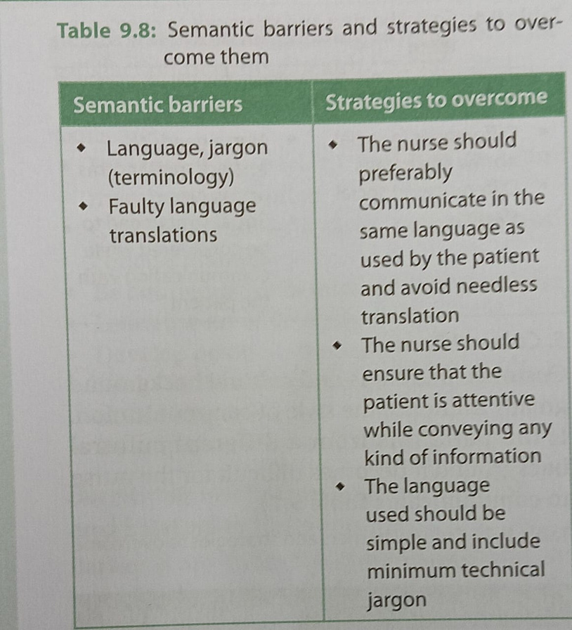

Slide 10
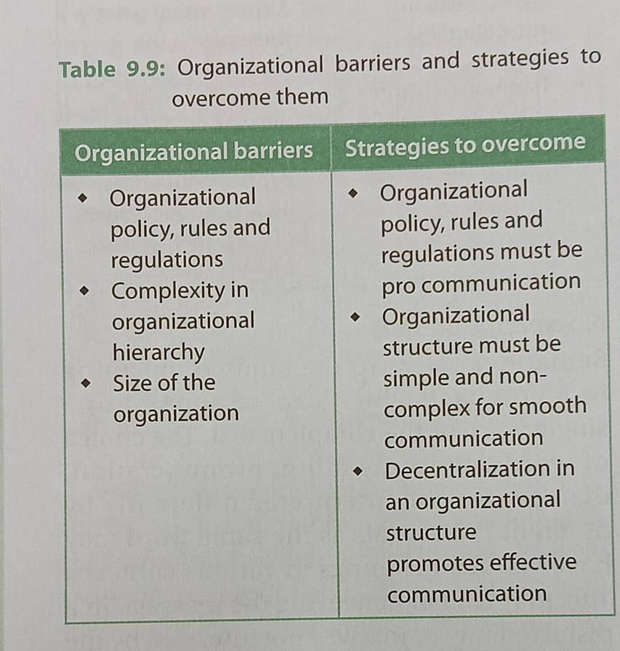

Slide 11
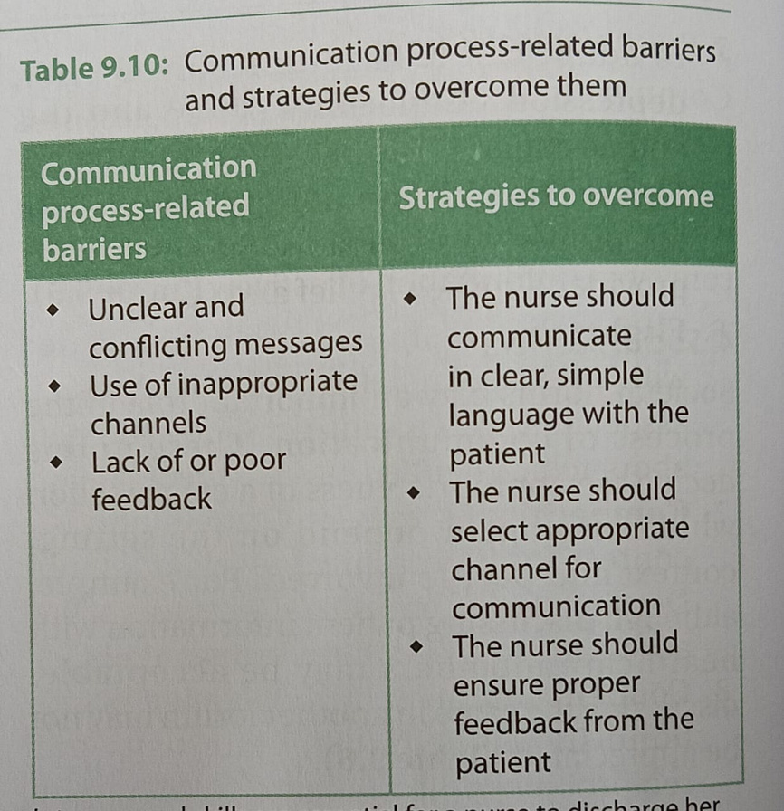

Slide 12
Work life balance
Work life balance refers to effective management of dual role at work and family.
Work life balance means harmony between ones job and ones professional life .
Work life balance is *"The extent to which an individual is equally self-engaged and satisfied
with his or her work role and family role."*
*_Greenhaus, Collins and Shaw (2003)*

Slide 13
IMPORTANCE OF WORK-LIFE BALANCE IN NURSING
🔅nursing is a demanding profession which requires scientific, interpersonal and emotional intelligence.
🔅Nurses deal with long working hours, shift system and frequent job rotations, under staffing, minimal resources, outdated equipment, demands of sick patients and emotional strain of caregivers put a lot of burden on her.

Slide 14
Benefits of maintaining work life balance
INDIVIDUAL BENEFITS
▫️Devolops self-esteem
▫️Maintains psychological wellbeing
▫️ Helps in attaining contentment
▫️ Helps to achieve harmony between work and life with minimum role conflict

Slide 15
Organizational benefits
▫️Reduced absenteeism
▫️Increased productivity
▫️Retention of skilled staff leading to reduction in training costs
▫️ Reduced staff turnover
▫️ Greater interest shown by skilled personnel to join the organization
▫️Continuous support from the employees

Slide 16
Individual strategies to maintain work like balance
🔸Assess job areas that are most demanding
🔸 Pay special attention to rest and relaxation while on night shift
🔸Build self care activities in daily routine and follow practice relaxation techniques
🔸Talk to friends, family or counselor to overcome stressors
🔸Be flexible at both work place and home
🔸Accept that everything cannot be changed
🔸Learn to delegate work
🔸Do not feel guilty while seeking assistance at work
🔸Feel free to decline politely

Slide 17
ORGANIZATIONAL STRATEGIES TO MAINTAIN WORK-LIFE BALANCE*
🔸Reduce long working hours
🔸Allow flexible working hours where permissible
🔸Provide part time jobs with less hours and fewer shifts
🔸Make job sharing arrangements
🔸Make leave taking more flexible
🔸Allow staff to take extra leave by forgoing pay

Slide 18
🔸Provide access to child care
🔸provide subsidies for child care
🔸Allow recieving of urgent telephone calls or messages from family members while at work
🔸Offer programs for employees to return to work after extended leave

Slide 19
Work place rule for happy life
🔅Wold mental health day 2017 was observed with "Mental health in the workplace" as the central theme.
🔅 The overall objective was to raise an awareness on mental health issues and mobilize efforts in support of better mental health
▫️Trust no one but respect everyone
▫️Never carry office gossips back home

Slide 20
▫️ Enter office on time and leave on time
▫️ Never make relationships at workplace
▫️Never rush for your position
▫️Never run behind office stuff
▫️ Avoid taking everything on your ego
▫️ Does not matter how people treat you
▫️Nothing matters except family

Slide 21
SURVIVAL STRATEGIES
Survival strategies are specific stress responses which include specific adaptive and maladaptive, biological, psychological and social constituents. They form four complimentary pairs-rescue and attachment, assertiveness and adaptation, fight and flight and competition and cooperation.

Slide 22
Time management
Time isn't the main thing. It's the only thing." - *Miles Davis*
'It is not enough to be busy... The questions is: what are we busy about?"
-Henry David Thoreau
'Lack of direction, not lack of time, is the problem. We all have twenty-four hour days."
-ZigZiglar

Slide 23
Time management refers to the allocation of available time among specific activities based on certain priorities while giving preference to individual likes and dislikes.
It is an important soft skill that can be applied in almost every job and almost for everybody.
Good time management allows one to work smarter if not harder.
It gets the individual to do more in less time and enhances the ability to function effectively even under time pressures.

Slide 24
Some of the important benefits of time management
• Makes the individual more organized and confident
•Creates more opportunities for advancement in profession and reaching life goals
•Improves professional reputation
•Results in greater productivity and efficiency by cutting on poor work flow
•Reduces stress
•Allows greater control over job responsibilities.

Slide 25
BUILDING TIME MANAGEMENT SKILL
Mastering time management skills requires dedicated effort and practice.
A few tips for Improving time management skills are as under:
•Prepare a time table for the routine
•Start early in the day
•Set goals for each study session
9•Start working on assignments early
•Learn to differentiate between urgent and important

Slide 26
•Do not over commit
•Develop routines
•Work on one thing at a time
•Take short breaks during study hours
•Eliminate or minimize distractions
•Get adequate sleep
•Allow time for the unexpected
•Keep a track of learning
• Set reasonable time for each goal

Slide 27
Coping with stress
Stress is a universal phenomenon commonly experienced by most people. It is often defined as a state of emotional strain or tension resulting from adverse or demanding circumstances.
Stress affects the whole person across all dimensions, viz., physical, emotional, intellectual, social and spiritual.
It comprises of three components: a stressor, perception of the event and the response.

Slide 28
STRESSOR
Stressor is the life change or extra demand which is the root of the problem.
PERCEPTION OF THE EVENT
How an individual views the stressor and relates himself or herself to it is referred to as the perception of the event.
RESPONSE
Response is the way the body, behavior and thinking patterns change.
COPING
Coping includes efforts to control, reduce or tolerate the threats caused due to stress.

Slide 29
PHYSICAL/BEHAVIOURAL
It involve taking care of oneself and staying as healthy as possible.
♦️Physical activities like walking, aerobic exercises, climbing stairs, cycling, gardening, swimming, house work, etc., reduce stress, improve mood and energy levels.
♦️Yoga and stretching: Even daily sessions of yoga and slow stretching in durations as small as 5-10 minutes can promote relaxation and reduce stress.
♦️Diet rich in vegetables, fruits, whole grains, low fat dairy, lean meat, limited salt, sugar and saturated fats intake acts as a stress reducing agent.
♦️Adequate rest and sleep regulates the mood and helps the individual to cope with stressful situations.
♦️Relaxation techniques such as deep breathing exercises, progressive muscle relaxation, guided imagery meditation, mindful meditation, etc., slow breathing and heart rate, lower blood pressure and balance both the body and the mind.

Slide 30
COGNITIVE/MENTAL
IT involve using thoughts and the mind constructively to counteract negative effects of Stress.
♦️Problem solving: These techniques help to choose the best alternative and also manage stress.
♦️Sometimes interpretation of a stressor can magnify its impact and make it feel more stressful than it really is.
♦️Effective time management allows individuals to maintain work-life balance, enhance sense of control, invest time on right things, better organize things, and improve efficiency. All these contribute to reducing stress precipitating factors.

Slide 31
♦️Assertiveness is the ability to express one's feelings and declare one's rights while respecting the feelings and rights of others
♦️Some activities that can effectively reduce stress by handling negative emotions are writing a diary, crying out, talking to a friend, participating in favorite activities, taking a hot bath or a cold shower.

Slide 32
PERSONAL/SOCIAL
It involve having social support networks, taking care of current relationships, exploring and developing personal interests.
♦️Friends and family members can prevent triggering of stress by reaching out before the situation goes out of control.
♦️Social support is often mutual; relationships are maintained by reviewing, planning and nurturing.
♦️Develop hobbies and personal interests, enjoy nature and outing, go for a walk in a park, get away from routine life, relax when possible, love yourself by avoiding self-criticism, praise and support, be gentle and kind to yourself, take care of the body, connect with the inner self and volunteer for community activities. All these activities can be rewarding and satisfying resulting in control and reduction of stress.

Slide 33
RESILIENCE
"Resilience is the process of adapting well in the face of adversity, trauma, tragedy, threats or even significant sources of stress."
The American Psychological Association (2014)
• Resilience though viewed as a personality trait.it can be learnt and developed as a skill over a period of time
- It doesn’t eliminate problems but it gave ability to see beyond them.
- It help to overcome mental health challenges like anxiety and depression.
- It enables both personal recovery and support for others in similar situations.

Slide 34
FACTORS CONTRIBUTING TO RESILIENCE
1]Biological factors:
•Good physical and mental health
•Balanced diet
•Healthy life style practices
2]Psychological Factors:
- Setting and achieving realistic goals
- Confidence and high self-esteem
- optimistic outlook and ability to adapt to change
- ⁠adequate problem solving skills
- Learning from past experiences

Slide 35
3]Social factors
- Strong relationships within and outside the family
- Access to community resources
- Supportive government policies and programs
- Role models and mentors
4]Cultural factors
Cultural factors help people handle tough situations.
•Belief systems
•Cultural practices
•social class status
•cultural background( tradition, values,language, customs and norms)

Slide 36
Development of resilience
•Build a Perception:See obstacles as challenges to overcome, not barriers to stop you
•Leverage Strengths: Know your strengths or seek help to identify them for guidance in tough times.
•Stay Positive:Believe in yourself and your abilities to overcome challenges
•Stay connected :
Building strong relationships which gives you support and acceptance during both good and tough times.
•Care for Self: Take care of your needs, enjoy activities, eat healthy, exercise, sleep well, and reduce stress.

Slide 37
•Be Hopeful: Accept the past and stay positive about the future.
•Be Realistic:Set achievable goals and take action.

